Slide 1

Augmented Reality
based education app The Human Heart

Slide 2

Augmented Reality (AR) can be used to create a more exciting and interactive learning experience for students. The more engaged a student is during a presentation directly correlates with how much information they retain. This application can be expanded to cover more subjects and be a better learning tool.

Slide 3
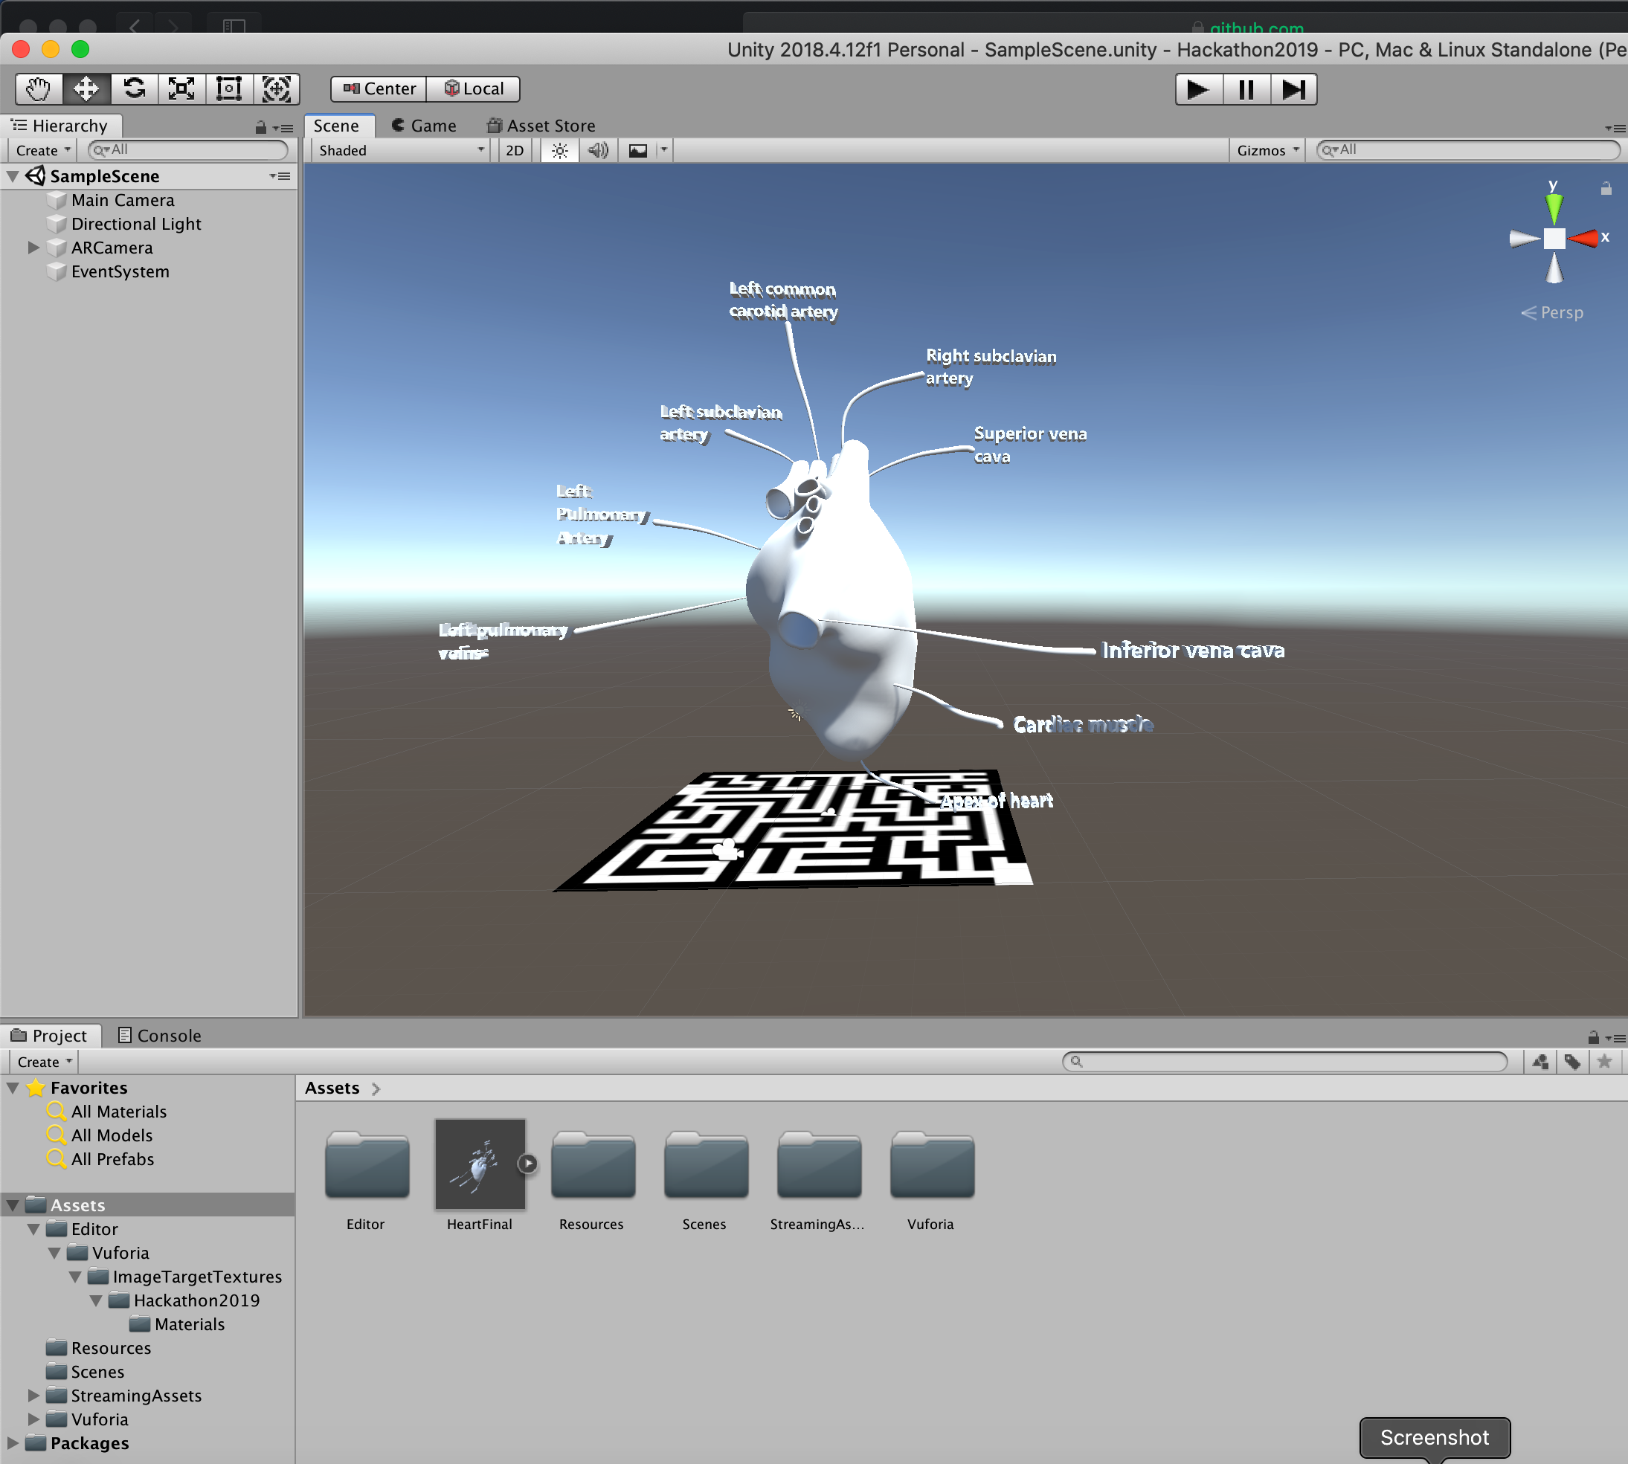
We used unity for developing our application. Using a model of the human heart, we can easily identify features and provide a full view that students can view on their own devices.

Slide 4
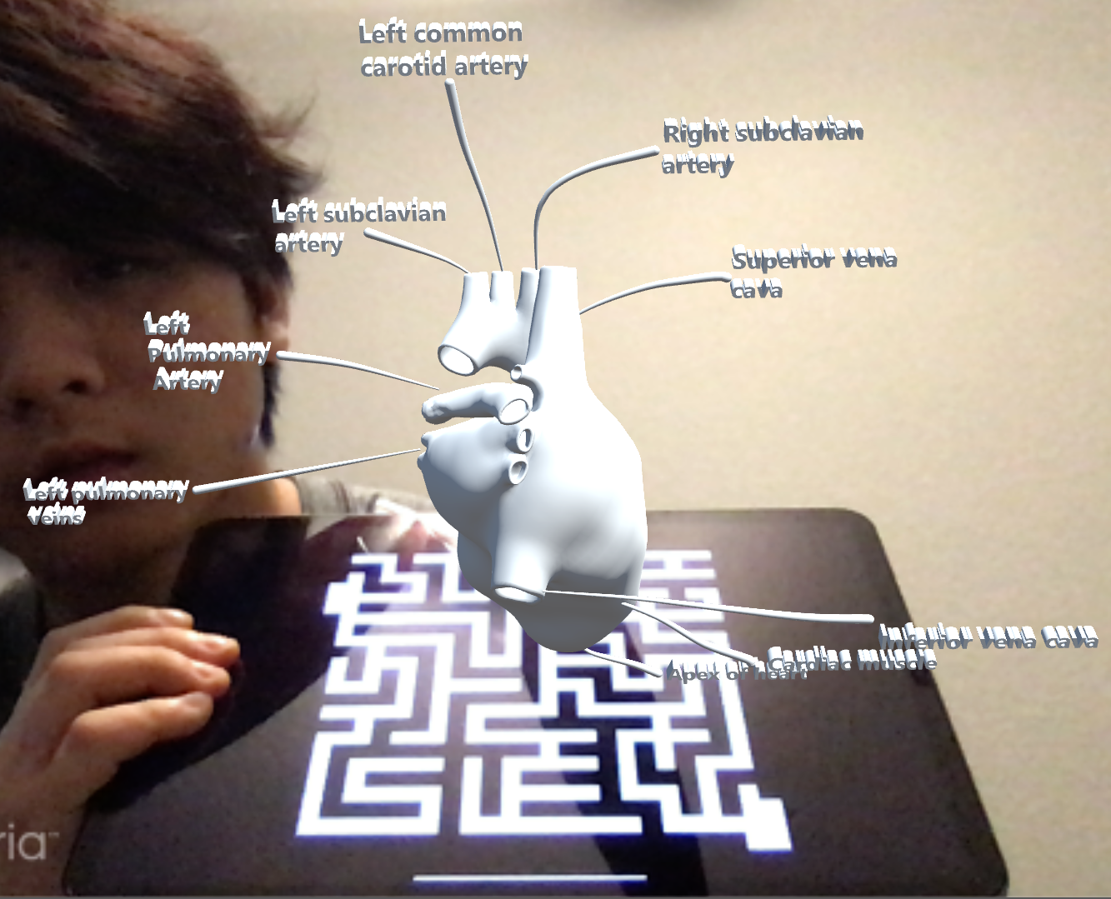

Slide 5
